Slide 1


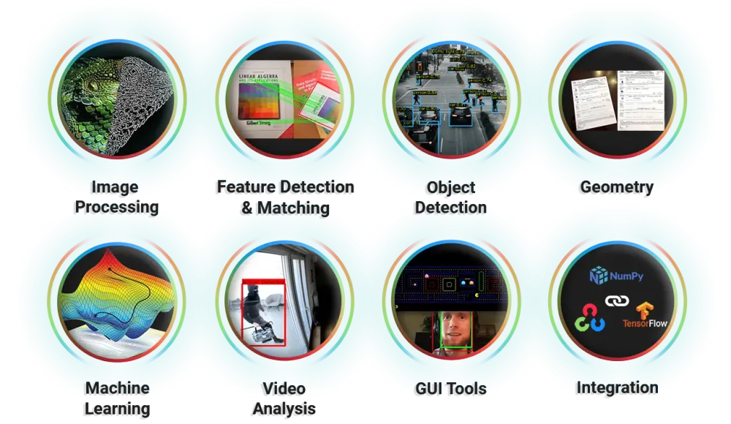
Session 11:
Combining Multiple Operations

Slide 2
Why Combining Multiple Operations ?
Introduction
Why combining multiple OpenCV operations matters:
Real-World Applications – From social media filters (e.g., Instagram, Snapchat) to medical imaging, multi-step image processing powers modern tools.
Beyond Basic Edits – Single operations (e.g., blurring) are limited; chaining them enables advanced effects like background replacement or meme generation.
Efficiency – Pipelines automate workflows (e.g., resize → enhance → watermark) instead of manual step-by-step edits.
Adaptability – Techniques apply across domains: photography, robotics (object detection), and augmented reality (AR).
Foundation for AI – Preprocessing (e.g., masking, noise reduction) is critical before feeding images to machine learning models.

Slide 3
Learning Outcome
By mastering combined OpenCV operations, students will be able to:
Design Image Processing Pipelines – Sequentially apply filters, transformations, and overlays for custom results.
Troubleshoot Complex Workflows – Diagnose issues like dimension mismatches or masking errors in multi-step code.
Build Practical Tools – Create projects like virtual backgrounds, photo editors, or automated meme generators.
Optimize Performance – Balance speed and quality (e.g., reducing resolution before heavy computations).
Prepare for Advanced Topics – Smoothly transition to computer vision (object tracking) or deep learning (image segmentation).

Slide 4
Script to Combine Grayscale, Resize, and Add Text
import cv2
import numpy as np
cv2 is OpenCV: used for image processing.
numpy is used for numerical operations (not directly used in this example, but often useful).
image = cv2.imread('cat.jpg') # Replace with your image path
This line loads the original image (cat.jpg) from your computer using OpenCV.
The image is loaded as a color image in BGR format.
gray_image = cv2.cvtColor(image, cv2.COLOR_BGR2GRAY)
Converts the image from BGR to Grayscale (removes color).
Useful for processing, filtering, and saving memory.

Slide 5
resized_image = cv2.resize(gray_image, (280, 500)) # New width=280, height=500
Resizes the grayscale image to a new width (280 px) and height (500 px).
Keeps processing consistent and standardized.
text_image = cv2.cvtColor(resized_image, cv2.COLOR_GRAY2BGR)
Since the image is grayscale, you convert it back to BGR so that colored text can be added (grayscale images can only have shades of gray).
text = "OMOTEC Project"
position = (50, 50) # (x, y) coordinates
font = cv2.FONT_HERSHEY_SIMPLEX
font_scale = 1
color = (0, 255, 0) # Green text (BGR format)
thickness = 3

Slide 6
Sets the parameters for the text:
"OMOTEC Project" is the text.
(50, 50) is the starting location of the text.
Font, size, green color, and thickness are defined.
cv2.putText(text_image, text, position, font, font_scale, color, thickness)
Actually draws the text on the image using the settings above.
cv2.imwrite('processed_image.jpg', text_image) # Save the final image
Saves the image with text to disk as 'processed_image.jpg'

Slide 7
cv2.imshow('Final Image', text_image) # Final output with text
cv2.imshow('Original Image', image) # Original full-color image
cv2.imshow('Resized Image', resized_image) # Grayscale resized version
cv2.waitKey(0) # Waits for any key press
cv2.destroyAllWindows() # Closes all OpenCV windows

Slide 8
Write a script to apply grayscale conversion, resizing, and text addition together.
import cv2
import numpy as np
# Load an image
image = cv2.imread('cat.jpg') # Replace with your image path
# --- Operation 1: Convert to grayscale ---
gray_image = cv2.cvtColor(image, cv2.COLOR_BGR2GRAY)
# --- Operation 2: Resize the image ---
resized_image = cv2.resize(gray_image, (280, 500)) # New width=280, height=500
# --- Operation 3: Add text ---
# Convert back to BGR color for colored text (OpenCV needs BGR for text on grayscale)
text_image = cv2.cvtColor(resized_image, cv2.COLOR_GRAY2BGR)

Slide 9
text = "OMOTEC Project"
position = (20, 50) # (x, y) coordinates
font = cv2.FONT_HERSHEY_SIMPLEX
font_scale = 1
color = (0, 255, 0) # Green text (BGR format)
thickness = 3
# Add text to the image
cv2.putText(text_image, text, position, font, font_scale, color, thickness)
cv2.imwrite('processed_image.jpg', text_image)# Save the final image
# Display the result
cv2.imshow('Final Image', text_image)
cv2.imshow('Original Image', image)
cv2.imshow('Resized Image', resized_image)
cv2.waitKey(0)
cv2.destroyAllWindows()

Slide 10
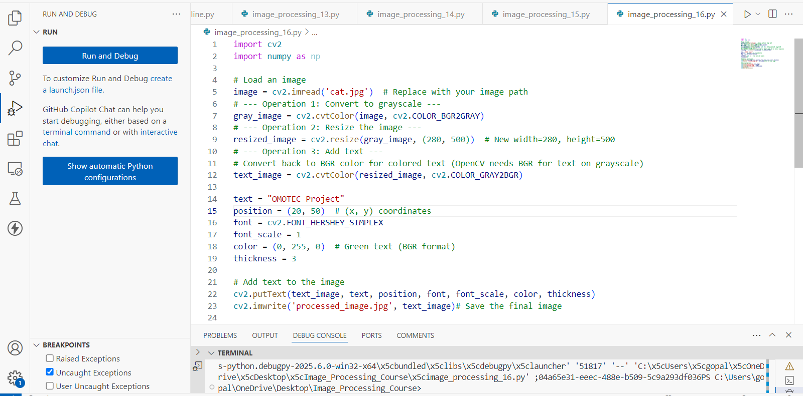

Slide 11
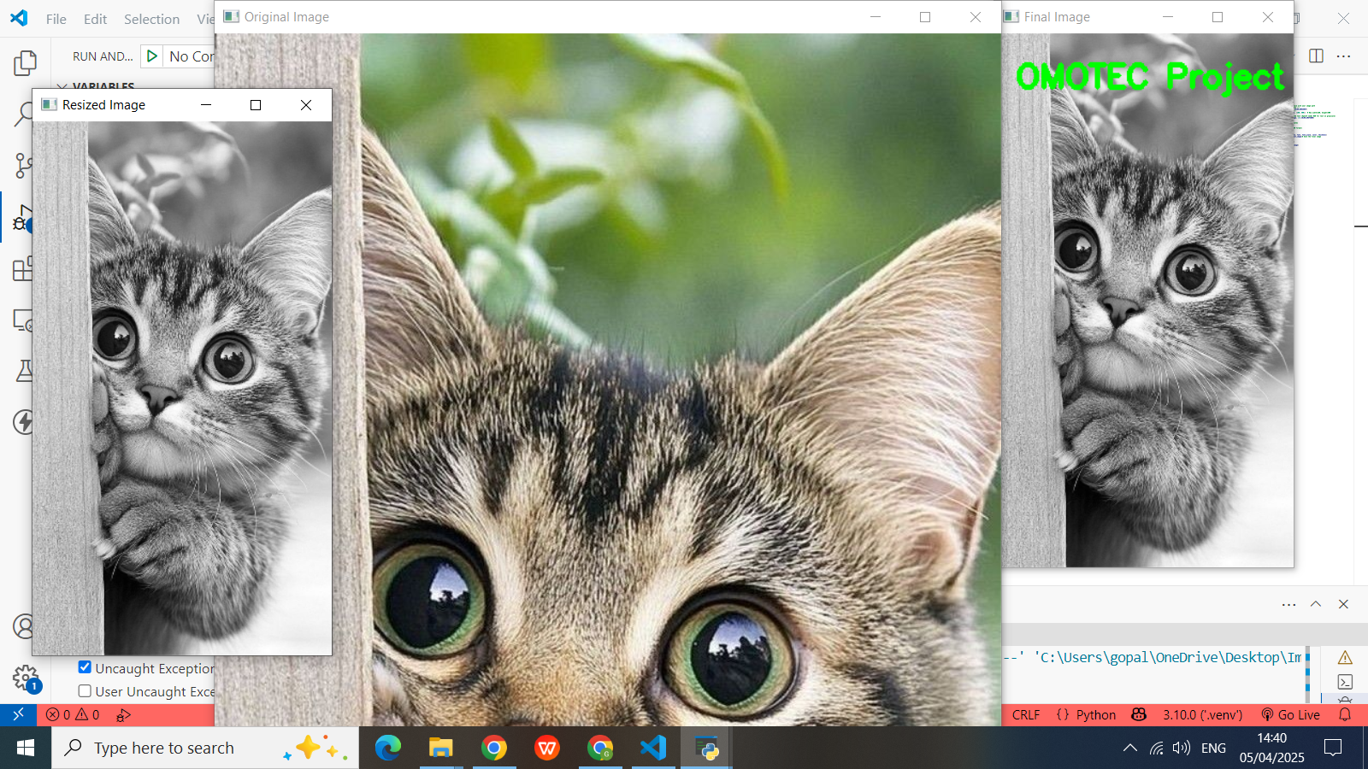

Slide 12
Code Explanation
Grayscale Conversion:
cv2.cvtColor(image, cv2.COLOR_BGR2GRAY) converts the image from BGR (OpenCV’s default) to grayscale.
Resizing:
cv2.resize() changes the dimensions. Use (width, height) as the parameter.
Adding Text:
OpenCV requires BGR format for colored text. Since the grayscale image is single-channel, we convert it back to BGR.
cv2.putText() adds text at specified coordinates.
Key Concept: Order of Operations
Changing the sequence of operations affects the result.
Try this: Resize the image before converting to grayscale. Compare the output quality!

Slide 13
Mini Project
mini photo editor project combining transformations, filters, cropping, and annotations using Python, OpenCV, and Tkinter (for a simple GUI). This project is designed for 8th graders with explanations and code:
Mini Project: Simple Photo Editor
Tools: Python, OpenCV, Tkinter (GUI), PIL/Pillow. Concepts Used: Filters, Cropping, Rotation, Text Annotation.
Install required libraries:
pip install opencv-python numpy pillow

Slide 14
Key Features
GUI Buttons:
Open, grayscale, rotate, flip, crop, add text, and save.
Operations:
Grayscale: Converts image to black-and-white.
Rotate: Rotates image 90° clockwise.
Flip: Mirrors the image horizontally.
Crop: Select a region with mouse (OpenCV popup).
Text: Adds green text at (50, 50).
Learning Outcomes
Integrate GUIs with image processing.
Understand order of operations (e.g., cropping before vs. after rotation).
Debug common issues (e.g., image not loading, incorrect paths).

Slide 15
Photo Editor
import cv2
import numpy as np
import tkinter as tk
from tkinter import filedialog, messagebox, simpledialog
from PIL import Image, ImageTk
class PhotoEditor:
def __init__(self, root):
self.root = root
self.root.title("Class 8 Photo Editor")
self.original_image = None
self.current_image = None
self.history = []
self.current_state = -1
self.create_widgets()

Slide 16
Photo Editor...
def create_widgets(self):
button_frame = tk.Frame(self.root)
button_frame.pack(side=tk.TOP, padx=5, pady=5)
tk.Button(button_frame, text="Open Image", command=self.open_image).pack(side=tk.LEFT)
tk.Button(button_frame, text="Grayscale", command=self.apply_grayscale).pack(side=tk.LEFT)
tk.Button(button_frame, text="Rotate 90°", command=self.rotate_image).pack(side=tk.LEFT)
tk.Button(button_frame, text="Flip Horizontal", command=self.flip_image).pack(side=tk.LEFT)
tk.Button(button_frame, text="Crop", command=self.start_crop).pack(side=tk.LEFT)
tk.Button(button_frame, text="Add Text", command=self.add_text).pack(side=tk.LEFT)
tk.Button(button_frame, text="Undo", command=self.undo).pack(side=tk.LEFT)
tk.Button(button_frame, text="Save", command=self.save_image).pack(side=tk.LEFT)
self.canvas = tk.Canvas(self.root, width=600, height=400)
self.canvas.pack()

Slide 17
Photo Editor...
def open_image(self):
path = filedialog.askopenfilename()
if path:
self.original_image = cv2.imread(path)
self.current_image = self.original_image.copy()
self.history = [self.current_image.copy()]
self.current_state = 0
self.show_image()
def show_image(self):
if self.current_image is not None:
img_rgb = cv2.cvtColor(self.current_image, cv2.COLOR_BGR2RGB)
img_pil = Image.fromarray(img_rgb)
img_tk = ImageTk.PhotoImage(img_pil)
self.canvas.config(width=img_tk.width(), height=img_tk.height())
self.canvas.create_image(0, 0, anchor=tk.NW, image=img_tk)
self.canvas.image = img_tk

Slide 18
Photo Editor...
def update_history(self, new_image):
if self.current_state < len(self.history) - 1:
self.history = self.history[:self.current_state + 1]
self.history.append(new_image.copy())
self.current_state += 1
self.current_image = new_image
self.show_image()
def apply_grayscale(self):
if self.check_image():
gray = cv2.cvtColor(self.current_image, cv2.COLOR_BGR2GRAY)
new_image = cv2.cvtColor(gray, cv2.COLOR_GRAY2BGR)
self.update_history(new_image)
def rotate_image(self):
if self.check_image():
new_image = cv2.rotate(self.current_image, cv2.ROTATE_90_CLOCKWISE)
self.update_history(new_image)

Slide 19
Photo Editor...
def flip_image(self):
if self.check_image():
new_image = cv2.flip(self.current_image, 1)
self.update_history(new_image)
def start_crop(self):
if self.check_image():
messagebox.showinfo("Crop", "Drag mouse to select area, then press Enter")
winname = "Select Crop Area"
cv2.namedWindow(winname, cv2.WINDOW_NORMAL)
cv2.imshow(winname, self.current_image)
roi = cv2.selectROI(winname, self.current_image, fromCenter=False, showCrosshair=True)
cv2.destroyWindow(winname)
if roi and all(i > 0 for i in roi[2:]):
x, y, w, h = roi
new_image = self.current_image[y:y+h, x:x+w].copy()
self.update_history(new_image)
else:
messagebox.showinfo("Info", "No area selected to crop.")

Slide 20
Photo Editor...
def add_text(self):
if self.check_image():
text = simpledialog.askstring("Text", "Enter text:")
if text:
new_image = self.current_image.copy()
cv2.putText(new_image, text, (50, 50), cv2.FONT_HERSHEY_SIMPLEX, 1, (0, 255, 0), 2)
self.update_history(new_image)
def undo(self):
if self.current_state > 0:
self.current_state -= 1
self.current_image = self.history[self.current_state].copy()
self.show_image()

Slide 21
Photo Editor...
def save_image(self):
if self.check_image():
path = filedialog.asksaveasfilename(defaultextension=".jpg")
if path:
cv2.imwrite(path, self.current_image)
def check_image(self):
if self.current_image is None:
messagebox.showerror("Error", "Open an image first!")
return False
return True
if __name__ == "__main__":
root = tk.Tk()
app = PhotoEditor(root)
root.mainloop()

Slide 22
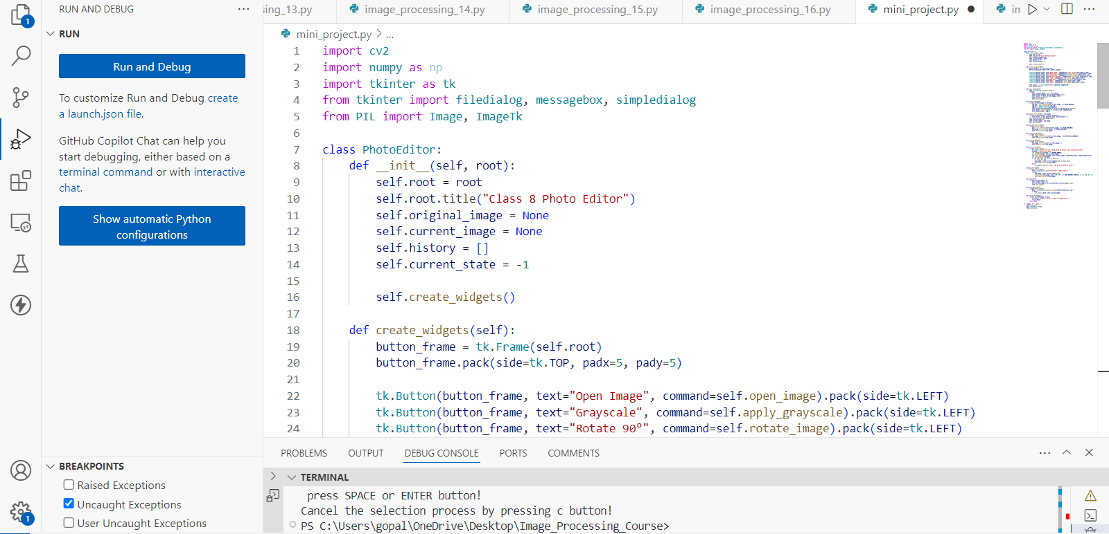

Slide 23
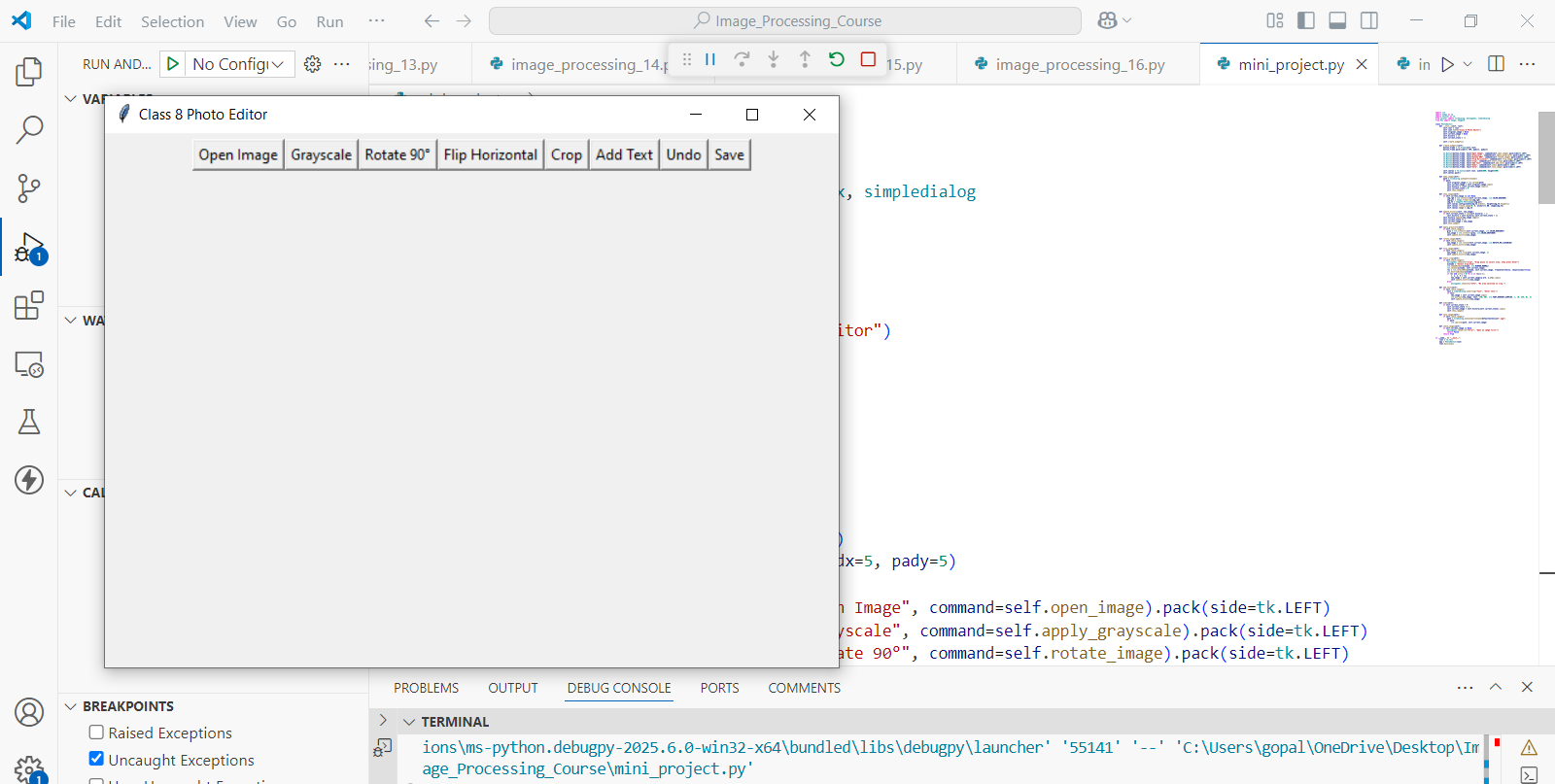

Slide 24
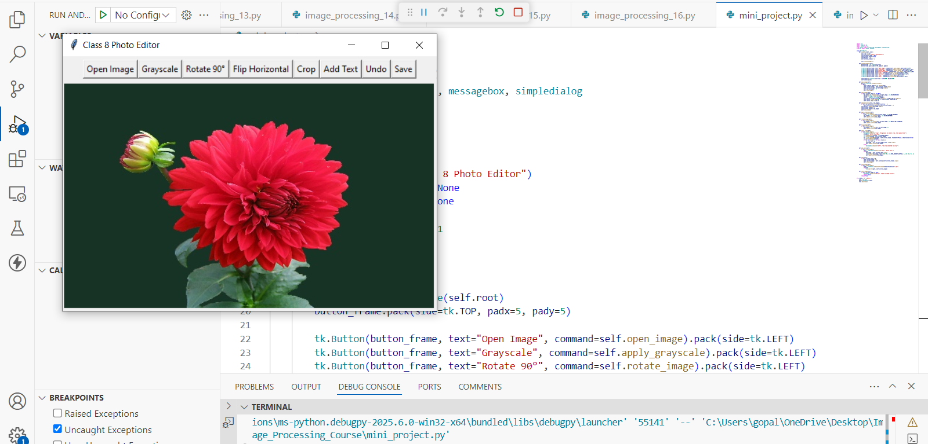

Slide 25
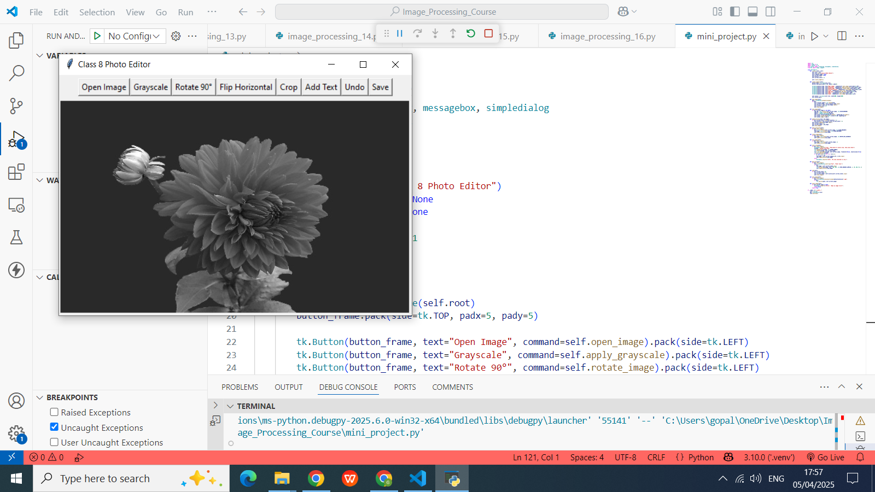

Slide 26
Exercise
1. What is the main reason for combining multiple image processing operations in OpenCV? A. It makes the code shorter B. It eliminates the need for NumPy C. It enables advanced effects and efficient pipelines D. It removes the need for a user interface
Answer: C. It enables advanced effects and efficient pipelines
2. Before adding colored text to a grayscale image in OpenCV, what must be done? A. Convert it to binary B. Resize it C. Convert it back to BGR format D. Save the image first
Answer: C. Convert it back to BGR format

Slide 27
Exercise
3. In the example project, which Python library is used to build the GUI for the mini photo editor? A. PyQt B. Tkinter C. Matplotlib D. Seaborn
Answer: B. Tkinter
4. What does the cv2.selectROI() function allow the user to do? A. Rotate an image B. Add text at a random location C. Select a crop area with the mouse D. Apply automatic filters
Answer: C. Select a crop area with the mouse

Slide 28
Exercise
5. Why is the order of image processing operations important?
A. OpenCV does not support parallel processing
B. It affects the output quality and result
C. Code runs only in a specific order
D. Libraries require alphabetical order of functions
Answer: B. It affects the output quality and result

